Slide 1


Cutting-edge Weather Station: Advanced Monitoring of AQI and Meteorological Forecasting
By
Project Group No.: G
Project ID: NIET/2023-24/CSE-IoT/07–09
Aman Vishwakarma (20013331550006)
Hemant Kumar Verma (20013331550015)
Nishchal Srivastava (20013331550021)
Sahil Srivastava (2001331550031)
Under the Supervision of
Mr. Mayank Deep Khare
Assistant Professor (CSE-IoT)
Department of CSE-IoT
Noida Institute of Engineering and Technology, Greater Noida

Slide 2
Outline
Introduction
Objectives
Motivation
Literature Survey
Problem formulation & proposed work
Project Execution Plan
Technical description
Block Diagram
Conclusion
Applications
Future Scope
References
NIET, GREATER NOIDA

Slide 3
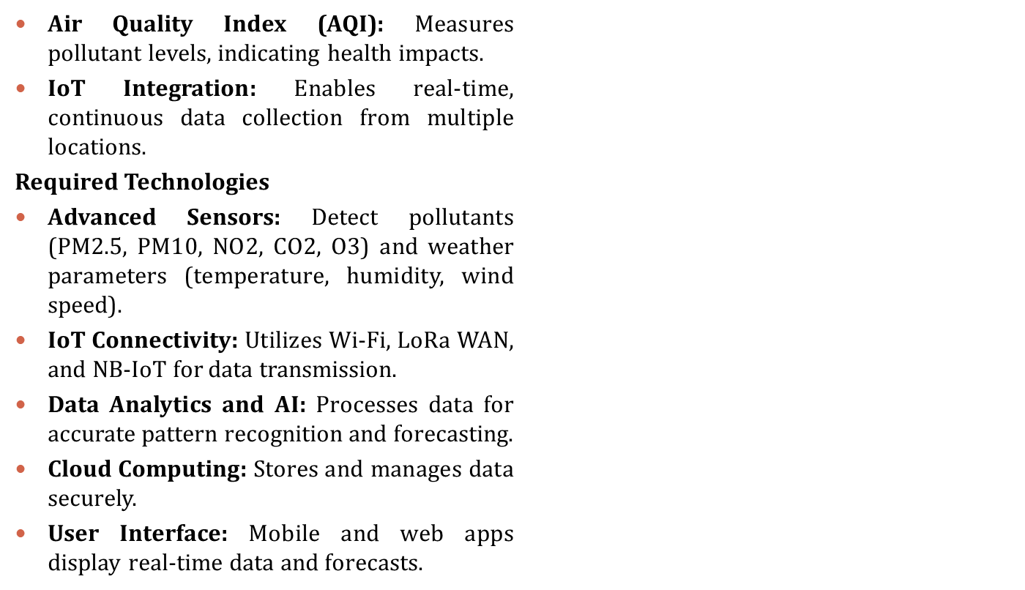
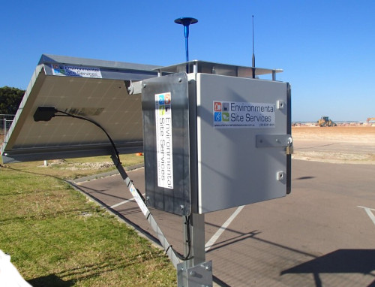
Introduction
NIET, GREATER NOIDA

Slide 4
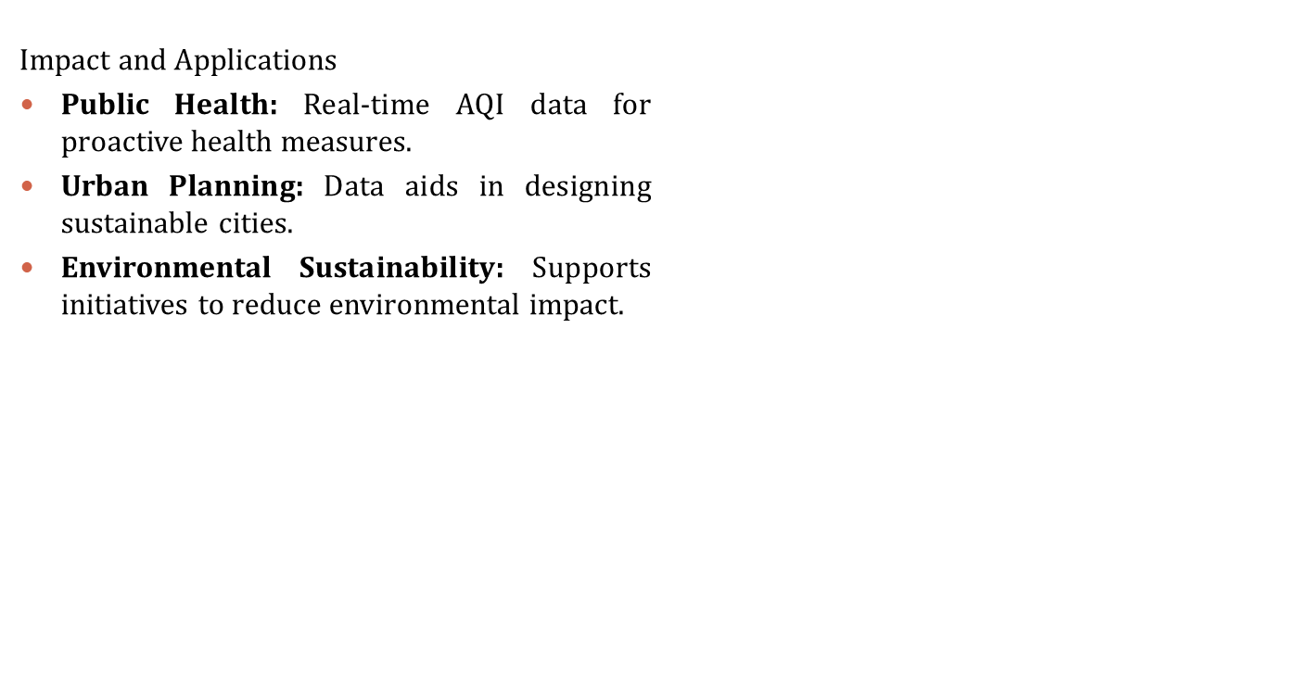
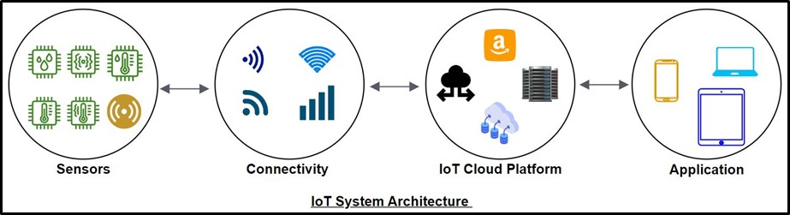
Introduction
NIET, GREATER NOIDA

Slide 5
Objectives
Real Time Monitoring: Provide continuous real time monitoring for prompt responses.
Air Quality Assessment: Quantify pollutants to identify and address health risks.
Meteorological Data Collection: Gather comprehensive meteorological data for accurate forecasting.
Weather Forecasting: Implement models to predict meteorological conditions.
Public Awareness and Education: Raise public awareness about air quality and health impacts.
Integration with Emergency Response Systems: Integrate data for efficient emergency responses.
Continuous Improvement and Innovation: Embrace technological advancements for ongoing effectiveness.
NIET, GREATER NOIDA

Slide 6
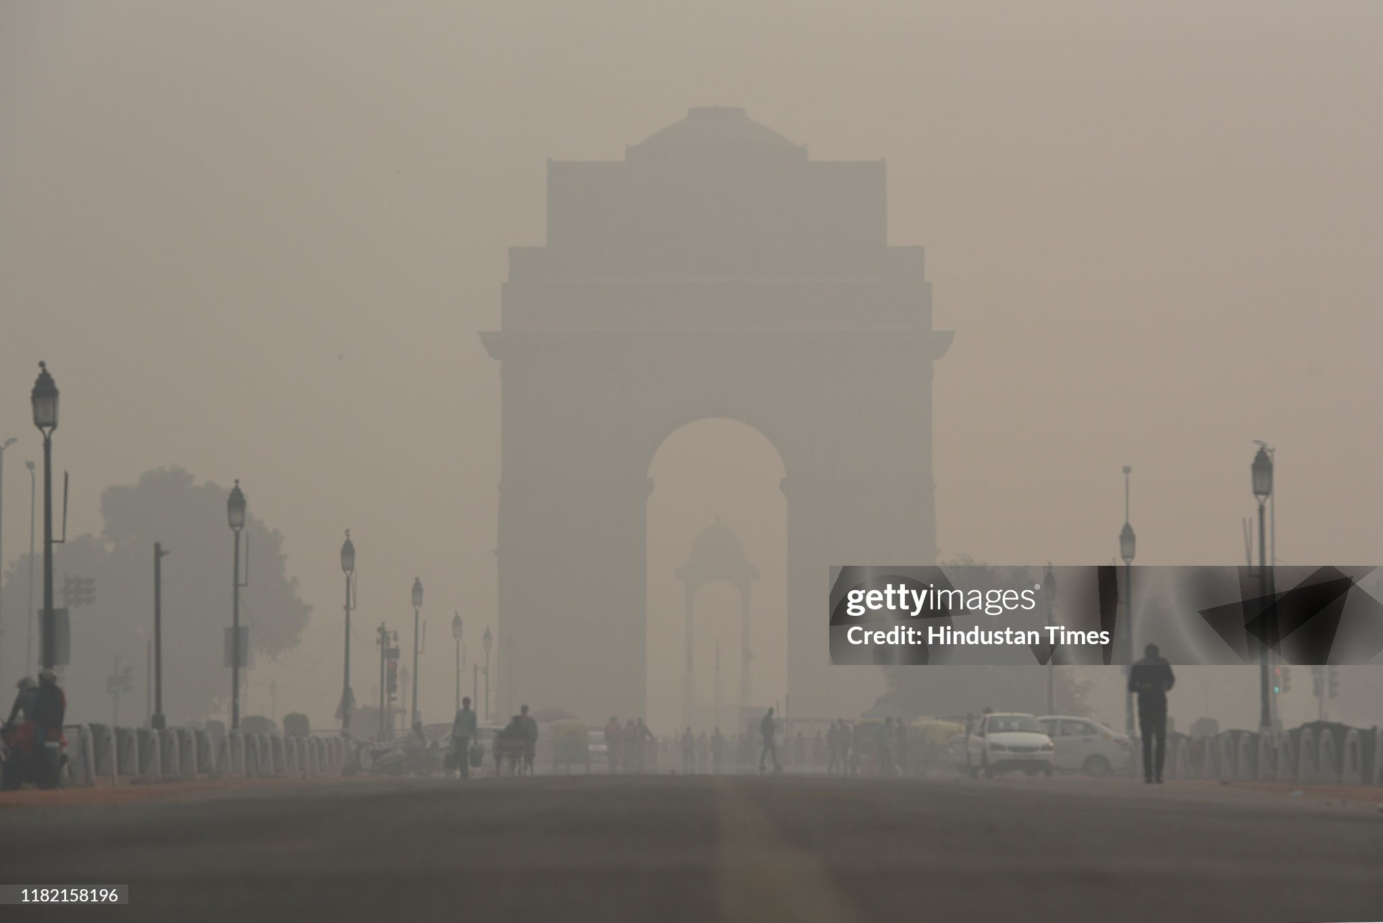
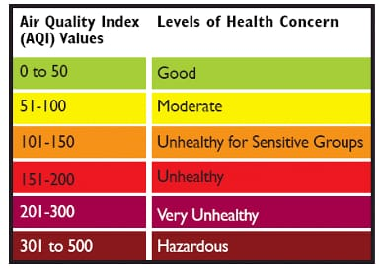
Motivation
This initiative's unwavering dedication to improving public health outcomes, fostering environmental consciousness, and assisting in wise decision-making in response to changing weather patterns and variations in air quality is what motivates it.
By providing accurate and timely information for preventative actions and focused treatments, the main objective is to significantly contribute to sustainable living environments and healthier communities.
NIET, GREATER NOIDA

Slide 7
Literature Survey
S. No. | Title | Year | Author | Publication | Remarks
1 | Evaluation of Machine Learning Algorithms for Air Quality Index (AQI) Prediction | 2023 | Alka Pant1, Sanjay Sharma2 and Kamal Pant3 | Journal of Reliability and Statistical Studies | This study assesses machine learning techniques for Air Quality Index (AQI) prediction. Pros include the possibility of precise forecasting, which could support initiatives to reduce pollution. Cons could include difficulties with interpretability, model complexity, and data variability.
2 | The Air Quality Index (AQI) in historical and analytical perspective a tutorial review | 2023 | Seth A. Horn, Purnendu K. Dasgupta | Talanta | With an examination of the Air Quality Index's (AQI) historical evolution and analytical frameworks, this research study provides a thorough pedagogical overview. The growth of the AQI, its importance in raising public awareness, and the analytical techniques used in its computation are all covered in detail. In order to comprehend air pollution and its effects on public health and regulatory policies, the study offers insightful information on the AQI.
NIET, GREATER NOIDA

Slide 8
Literature Survey
S. No. | Title | Year | Author | Publication | Remarks
3 | Forecasting of daily air quality index in Delhi | 2011 | Anikender Kumar, P. Goyal | Science of the Total Environment 409 (2011) | The study developed forecasting models for daily Air Quality Index (AQI) in Delhi using statistical methods, showing Combination of both ARIMA and PCR superior performance. Meteorological parameters' significance was assessed, finding minimal AQI variation between weekdays and weekends.
4 | A deep learning approach for prediction of air quality index in a metropolitan city | 2021 | R. Janarthanan , P. Partheeban , K. Somasundaram P. Navin Elamparithi | Sustainable Cities and Society 67 (2021) 102720 | The literature survey elucidates diverse methodologies, including deep learning and statistical models, for air quality prediction, emphasizing their application in urban settings. It underscores the critical role of accurate prediction in public health management and urban planning, fostering a deeper understanding of atmospheric dynamics and pollutant concentrations
NIET, GREATER NOIDA

Slide 9
Literature Survey
S. No. | Title | Year | Author | Publication | Remarks
5 | Assessment of spatio-temporal variations in air quality of Jaipur city, Rajasthan, India | 2017 | Ankita P. Dadhich, Rohit Goyal, Pran N. Dadhich | The Egyptian Journal of Remote Sensing and Space Sciences | The paper provides a comprehensive assessment of air quality in Jaipur city, employing geospatial and geostatistical techniques. It highlights seasonal variations in pollutants, identifies major contributors to air degradation, and correlates air quality with local weather parameters. The spatial analysis underscores critical areas requiring attention for pollution mitigation strategies.
6 | Air quality monitoring in Chennai, India, in the summer of 2005 | 2006 | M. Pulikesi, P. Baskaralingam, D. Elango, V.N. Rayudu,V. Ramamurthi S. Sivanesan | Journal of Hazardous Materials B136 (2006) 589–596 | The literature survey in Chennai during the summer of 2005 provided comprehensive insights into surface ozone (O3) dynamics, emphasizing its correlation with meteorological parameters and anthropogenic influences. While O3 and NOx remained within permissible limits, TSPM exceeded National Ambient Air Quality Standards (NAAQS) at select sites, underscoring the urgency for targeted pollution control measures in urban environments.
NIET, GREATER NOIDA

Slide 10
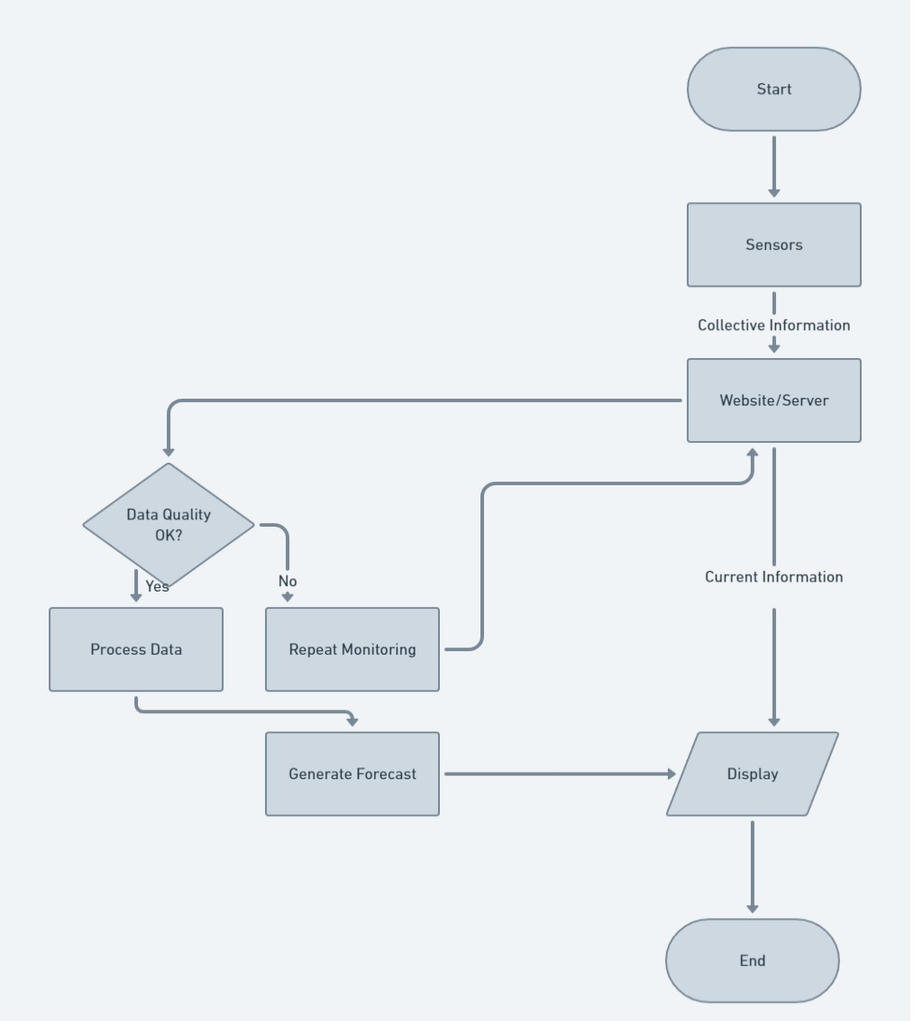
Project Execution Plan
NIET, GREATER NOIDA

Slide 11
Technical Description
Sensors :Collectively to calculate the AQI basically six parameters are considered ,so MQ-135 is used along with MQ-5
  MQ-135: Also Known as Air Quality Sensor
      It detects the O₃(OZONE) ,PM(10 AND 2.5), C0(CARBON MONOXIDE), S0₂(SULFUR DIOXIDE) and NO₃(NITROGEN OXIDE)
  MQ-5: Also known as Gas Sensor
      It detects the H₂, LPG, CH₄, C0 and ALCOHOL.
Board: Boards are used to collect and process the data from the sensors and works as a controller and passes the instruction to the sensors
  Arduino UNO: Based on the microcontroller ATmega328P chip it operates on 5 volts it contains 6 analog input pins.
  ESP8266: Also known as Wi-fi module , it operates on 3.3 volts .
NIET, GREATER NOIDA

Slide 12
Technical Description
Application/Website : By using Application/Website data is collected will be shown and along with the forecast that is made by using the data.
Forecasting: A trained model using the already given dataset and the information supplied by the sensor will predict the Meteorological status.
NIET, GREATER NOIDA

Slide 13
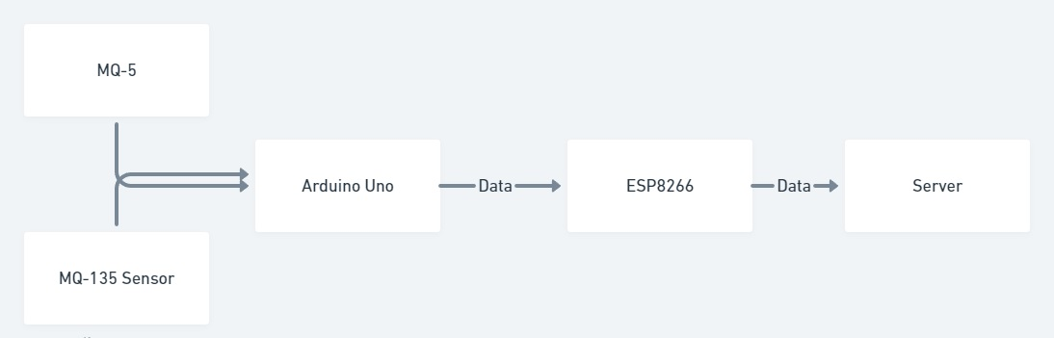
Block Diagram
NIET, GREATER NOIDA

Slide 14
Data Collection
1. Data Sources:
- Governmental agencies responsible for monitoring air quality.
- Meteorological departments providing weather data.
- Environmental monitoring stations collecting pollutant concentrations.
- Geographic databases for additional spatial information.
2. Data Types: - Meteorological data: Temperature, humidity, wind speed, precipitation, etc.
- Pollutant concentrations: PM2.5, PM10, Ozone, Nitrogen Dioxide, Sulfur Dioxide (SO2), Carbon Monoxide, etc
3. Data Collection Methods:
- Automatic sensors: Continuous monitoring stations providing real-time data.
- Manual measurements: Periodic sampling conducted by trained personnel.
- Remote sensing: Satellite imagery for broader coverage and spatial analysis.
- Data APIs: Accessing data through online APIs provided by relevant organizations.
4. Data Preprocessing:
- Cleaning: Removing outliers, erroneous readings, or missing values.
- Integration: Combining data from multiple sources into a unified dataset.
- Normalization: Scaling features to a common range to facilitate model training.
- Encoding: Converting categorical variables into numerical representations for modeling purposes.
NIET, GREATER NOIDA

Slide 15
Machine Learning Algorithm
Multivariate linear regression is a variant of standard linear regression that anticipates a dependent variable (such as AQI) using countless independent variables (features or predictors). In the context of AQI prediction, multivariate linear regression considers not just one, but several factors that influence air quality. A multiple linear regression model is predictions utilized to explain a correlation between one continuous dependent variable and two or more independent variables.
XGBoost: It can effectively predict Air Quality Index (AQI) by leveraging its ensemble of decision trees and gradient boosting techniques, offering accurate forecasts based on historical data of environmental factors and pollutant concentrations. Random Forest (RF) and XGBoost are decision tree-based models that vary in that XGBoost can decrease mistakes whereas RF cannot. XGBoost belongs to the ensemble learning family, specifically boosting algorithms. XGBoost utilizes the gradient boosting framework, which minimizes a predefined loss function by adding weak learners (decision trees) to the ensemble. It optimizes the model's performance by iteratively improving upon the residuals of the previous models.
NIET, GREATER NOIDA

Slide 16
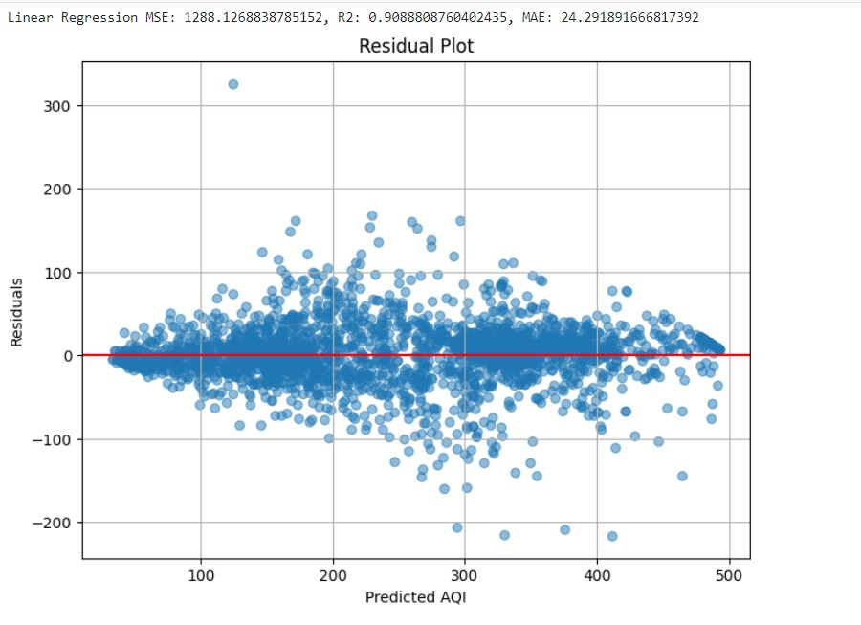
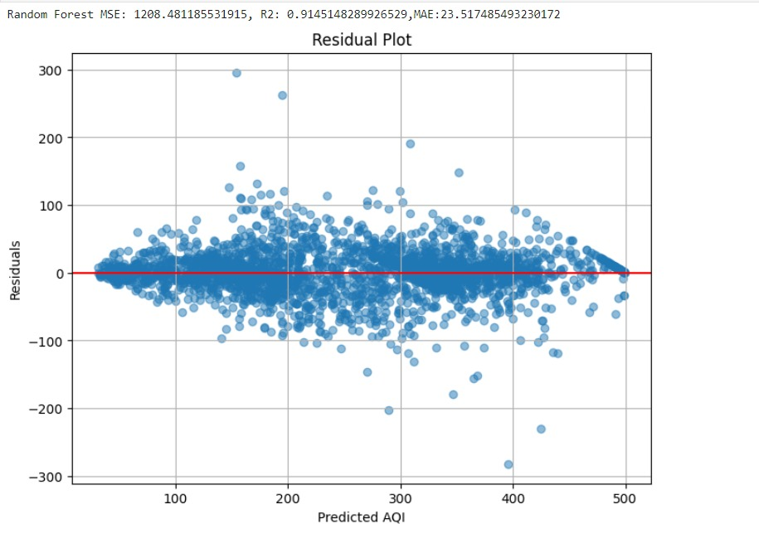
Graph Plot
NIET, GREATER NOIDA

Slide 17
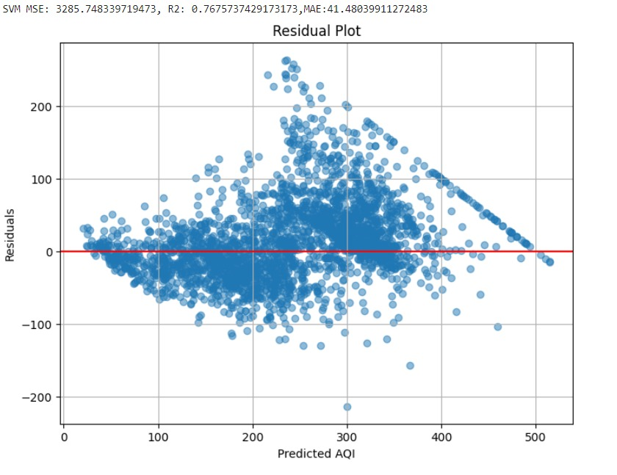
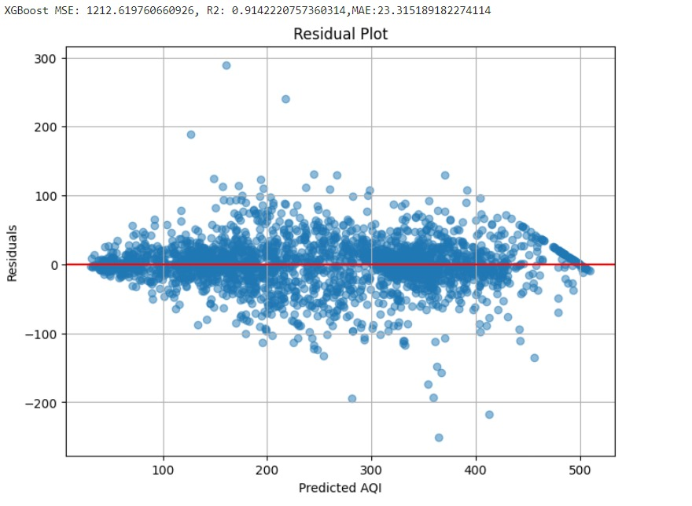
Graph Plot
NIET, GREATER NOIDA

Slide 18
Machine Learning Algorithm
Support Vector Machines (SVM): are a type of supervised learning model used for classification and regression tasks. Support vector machines (SVMs) are models for supervised learning that address data utilized for regression and classification. They are paired with learning algorithms. The key idea behind SVM is to find the hyperplane that optimally divides the classes in the feature space. This hyperplane is chosen in such a way that it maximizes the margin, which is the distance between the hyperplane and the nearest data point from each class, also known as support vectors.
Random Forest (RF): Within the collaborative training domain, Random Forest is an appreciated machine learning technique. It is a collection of decision trees, where each tree is trained on a random subset of the training data (bootstrapped samples) and at each split in the tree, only a subgroup of the features is acknowledged. The RF approach uses triggering classification and regression trees (CARTs). Each CART is built up of random vectors. . Random Forest is an ensemble learning approach, which means it combines the predictions of numerous independent models to get a single final prediction. Random Forest's individual models are decision trees.
NIET, GREATER NOIDA

Slide 19
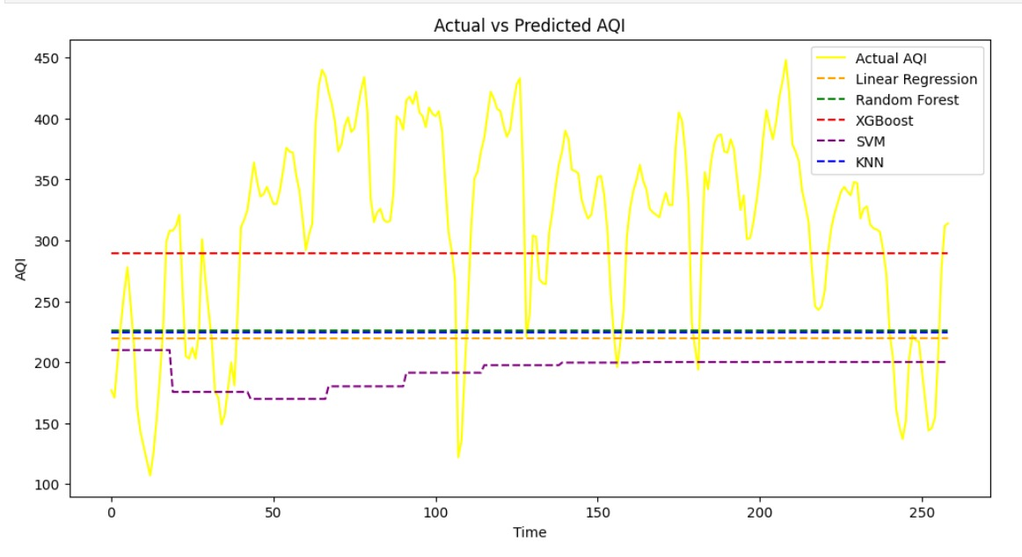
Result
(Prediction with normal dataset)
This figure illustrates the discrepancy between actual and predicted AQI values using various machine learning algorithms—linear regression, random forest, XGBoost, SVM, and KNN—applied to the standard dataset. The analysis reveals that XGBoost and Random Forest provide predictions that most closely align with the actual AQI data, demonstrating their superior accuracy and effectiveness in modeling and forecasting air quality.
NIET, GREATER NOIDA

Slide 20
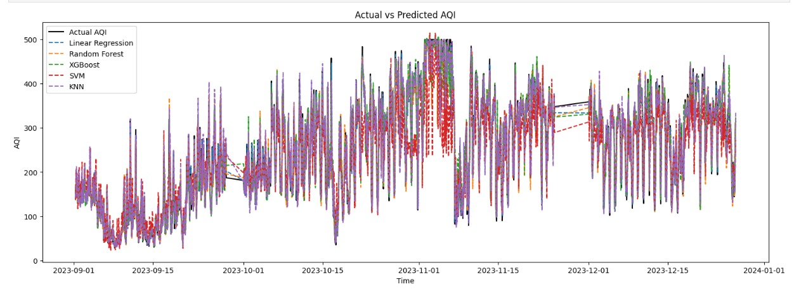
Prediction with optimized dataset
NIET, GREATER NOIDA

Slide 21
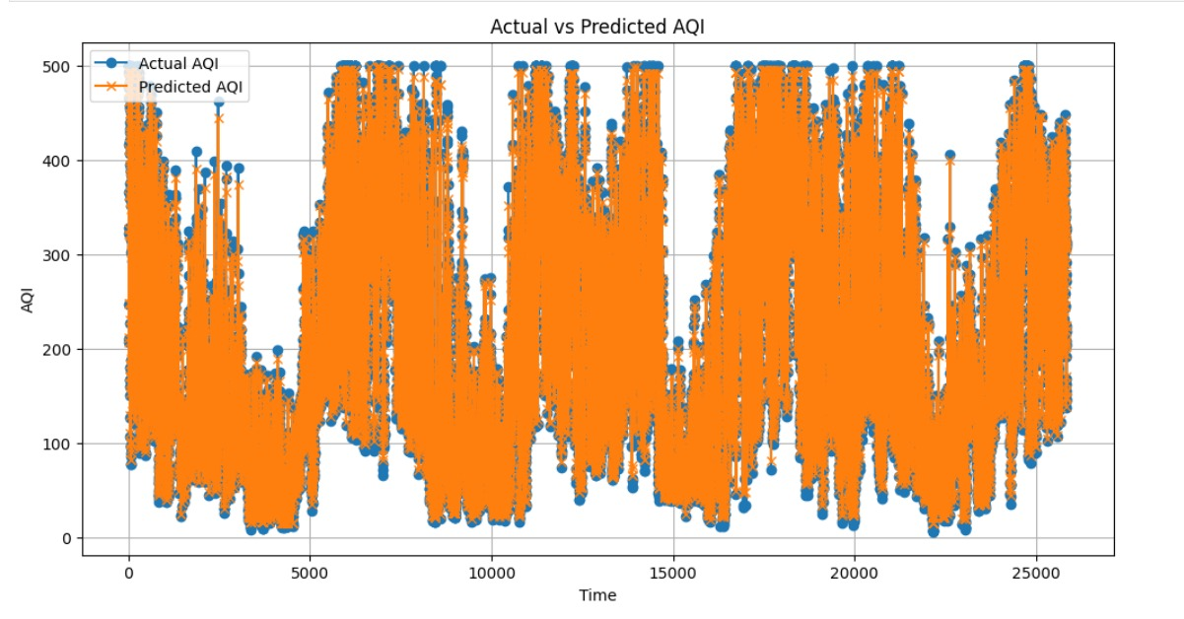
Prediction with optimized dataset with rainfall data
NIET, GREATER NOIDA

Slide 22
Conclusions
1. Summary of Key Findings:
- Recap the objectives of the project and how they were addressed through the development and evaluation of the Random Forest model for AQI prediction.
- Highlight the key insights gained from the analysis, including the performance of the model and factors influencing AQI levels.
2. Significance of the Project:
- Emphasize the importance of accurate AQI prediction for informing policy decisions, mitigating health risks, and raising awareness about air quality issues.
- Highlight the role of machine learning techniques in improving the precision and timeliness of AQI forecasts, contributing to proactive interventions and preventive measures.
3. Reflection on Challenges and Lessons Learned:
- Discuss any obstacles faced during data collection, preprocessing, model training, or evaluation, and how they were addressed.
- Reflect on the skills, methodologies, and insights gained through the project experience, acknowledging areas of personal and professional growth.
4. Future Directions: Outline potential directions for future research and development in the field of AQI prediction:
- Suggest avenues for enhancing the predictive accuracy and robustness of AQI models, such as incorporating additional data sources or exploring ensemble learning approaches.
- Identify emerging technologies or methodologies that could be leveraged to further advance the field, such as deep learning techniques or real-time data analytics
NIET, GREATER NOIDA

Slide 23
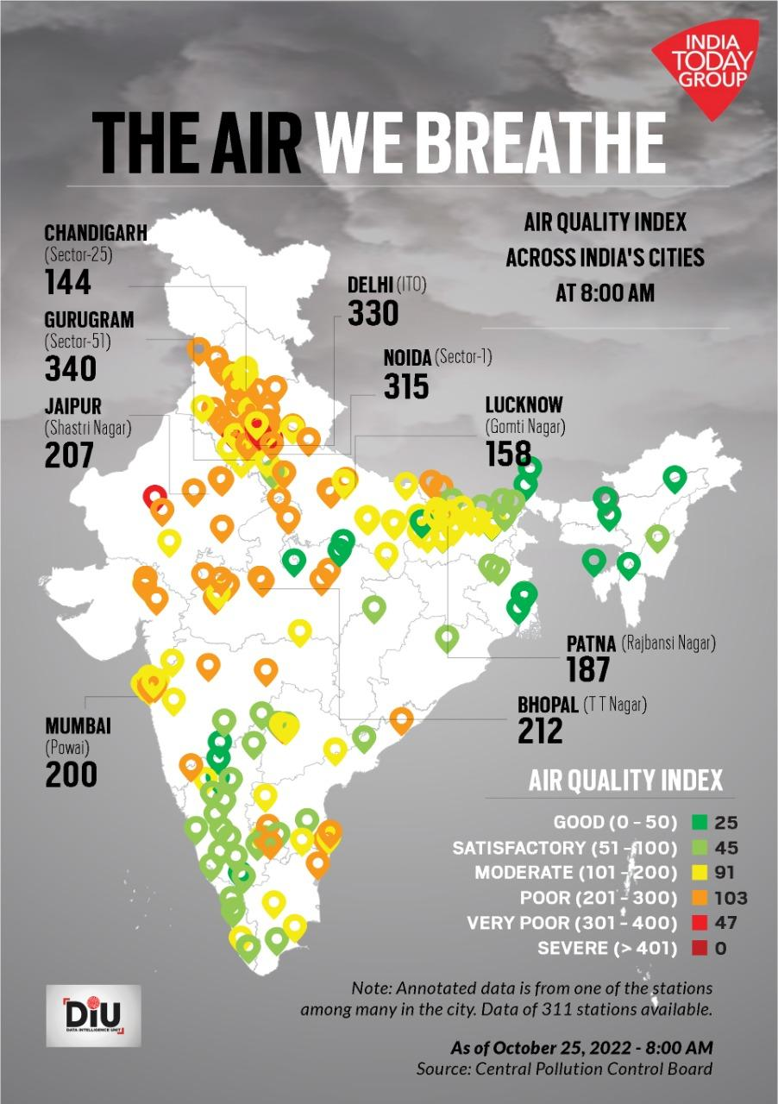
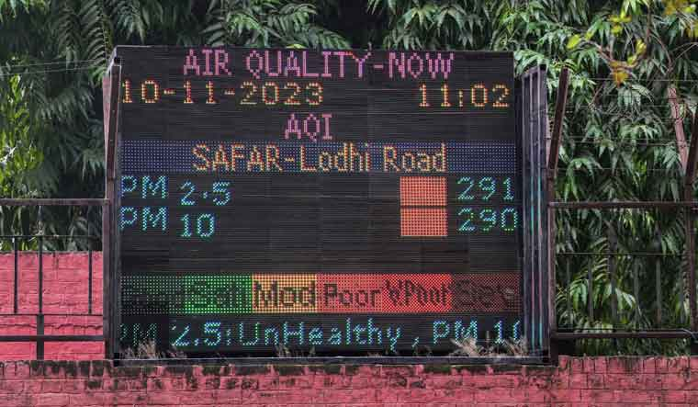
Applications
Public Health Management
Urban Planning and Development:
Environmental Compliance Monitoring:
Emergency Response and Disaster Management:
Agricultural Planning:
Air Quality Awareness and Education:
Research and Scientific Studies:
Tourism and Outdoor Activities:
NIET, GREATER NOIDA

Slide 24
Future Scope
Sensor Technology Advancements: Integrate cutting-edge sensors for improved data precision.
IoT Connectivity: Enhance connectivity for real-time data transmission and create an interconnected monitoring network.
AI and Machine Learning: Refine algorithms for more accurate predictions and anomaly detection.
Smart Cities Integration: Align with smart cities initiatives for urban planning and pollution control.
Mobile Apps for Public Engagement: Develop user-friendly apps for real-time information dissemination.
Climate Change Assessment: Expand to assess climate change impacts on local weather and air quality.
Research Collaborations: Partner with institutions for continuous validation and scientific research.
Emergency Response Integration: Integrate with emergency protocols for efficient responses.
Global Expansion: Scale the project globally for broader environmental monitoring efforts.
NIET, GREATER NOIDA

Slide 25
References
Environmental Science and Air Quality Monitoring: "Air Quality Management" by Thad Godish and Wayne T. Davis. "Introduction to Environmental Engineering and Science" by Gilbert M. Masters and Wendell P. Ela Guidelines and publications from environmental agencies (e.g., EPA, WHO) related to air quality monitoring.
Meteorology and Weather Forecasting: "The AMS Weather Book: The Ultimate Guide to America's Weather" by Jack Williams. "An Introduction to Dynamic Meteorology" by James R. Holton and Gregory J. Hakim Meteorological organizations and services (e.g., NOAA, ECMWF) for standards and guidelines.
Project Management: "A Guide to the Project Management Body of Knowledge (PMBOK Guide)" by Project Management Institute (PMI). "Scrum: The Art of Doing Twice the Work in Half the Time" by Jeff Sutherland "Agile Project Management with Scrum" by Ken Schwaber
Air Quality Monitoring Technologies: Research articles from journals in environmental science and technology. Manufacturer documentation for specific air quality sensors and monitoring equipment.
Data Analysis and Machine Learning in Meteorology: "Python for Data Analysis" by Wes McKinney. "Machine Learning for Dummies" by John Paul Mueller and Luca Massaron Academic papers and conferences on machine learning applications in meteorology.
NIET, GREATER NOIDA

Slide 26

Noida Institute of Engineering and Technology, Greater Noida
NIET, GREATER NOIDA

